Slide 1
Parameter data retrieval in Servlet

Slide 2
Objective
To learn
  Retrieve the data in server from client form
Jackson, Web Technologies: A Computer Science Perspective, © 2007 Prentice-Hall, Inc. All rights reserved. 0-13-185603-0

Slide 3
Outcome
Students will be able to
  Retrieve the data in server from any field present in the client form
Jackson, Web Technologies: A Computer Science Perspective, © 2007 Prentice-Hall, Inc. All rights reserved. 0-13-185603-0

Slide 4
Context
Servlet is the java program or module resides in the server to process the request
Jackson, Web Technologies: A Computer Science Perspective, © 2007 Prentice-Hall, Inc. All rights reserved. 0-13-185603-0

Slide 5
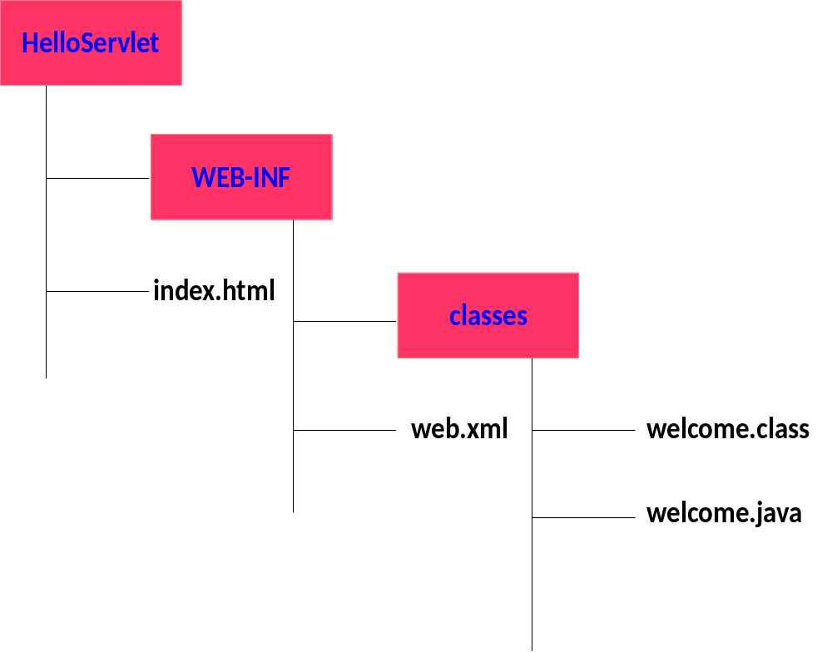
Development of our SecondServlet
Create the following hierarchy
Jackson, Web Technologies: A Computer Science Perspective, © 2007 Prentice-Hall, Inc. All rights reserved. 0-13-185603-0

Slide 6
Reading Form data
getParameter()
  request.getParameter() method to get the value of a form parameter.
getParameterValues()
  Call this method if the parameter appears more than once and returns multiple values, for example checkbox.
getParameterNames()
  Call this method if you want a complete list of all parameters in the current request.

Slide 7
getParameter() - Example
<html>
<body>
<form action="HelloForm" method=“get"> First Name:
<input type="text" name="first_name"> <br /> Last Name:
<input type="text" name="last_name" />
<input type="submit" value="Submit" /> </form> </body>
</html>
Request sent through “get” request
http://localhost:8080/HelloForm ?first_name=ZARA&last_name=ALI

Slide 8
getParameter() - Example
class public class HelloForm extends HttpServlet
{
public void doGet(HttpServletRequest request, HttpServletResponse response) throws ServletException, IOException
{
response.setContentType("text/html");
PrintWriter out = response.getWriter();
out.println("<html> <body>”);
out.println(“<b>First Name</b>: " +request.getParameter("first_name") );
out.println(“<b>First Name</b>: " +request.getParameter(“last_name") );
out.println("</body></html>");
}
}

Slide 9
getParameterValues() - Example
<html>
<body>
<form action="hello" method="POST“>
<input type="checkbox" value="maths" name="checkgroup" checked="checked" /> Maths
<input type="checkbox" value="physics" name="checkgroup" /> Physics
<input type="checkbox" value="chemistry" name="checkgroup" checked="checked" /> Chemistry
<input type="submit" value="Submit" />
</form>
</body>
</html>

Slide 10

getParameterValues() - Example
String[] paramValues =
request.getParameterValues("checkgroup");
// Read multiple valued data
out.println("<ul>");
for(int i=0; i < paramValues.length; i++)
{
out.println("<li>" + paramValues[i]);
}
Output
Print the values of the checked check boxes

Slide 11
Example – To get the values of all the parameters
if (paramValue.length() == 0)
out.println("<i>No Value</i>");
else
out.println(paramValue);
}
else {
// Read multiple valued data
out.println("<ul>");
for(int i=0; i < paramValues.length; i++) {
out.println("<li>" + paramValues[i]);
}
out.println("</ul>");
}
}
out.println("</tr>\n</table>\n</body></html>");
}
Enumeration paramNames = request.getParameterNames();
while(paramNames.hasMoreElements()) {
String paramName = (String)paramNames.nextElement();
out.print("<tr><td>" + paramName + "</td>\n<td>");
String[] paramValues =
request.getParameterValues(paramName);
// Read single valued data
if (paramValues.length == 1) {
String paramValue = paramValues[0];

Slide 12
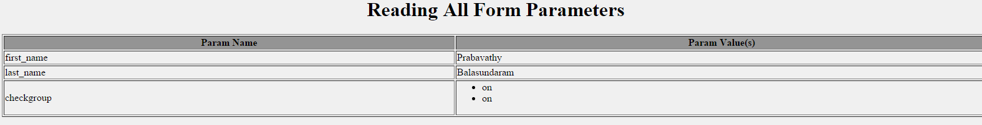
Output

Slide 13
Simple Questions
How do you retrieve the data from the text field?
How do you retrieve the data from the form field which is having more than one value?
How to retrieve the data from all the fields?
Jackson, Web Technologies: A Computer Science Perspective, © 2007 Prentice-Hall, Inc. All rights reserved. 0-13-185603-0

Slide 14
References
Deitel and Deitel and Nieto, ―Internet and World Wide Web - How to Program‖, Prentice Hall, 5th Edition, 2011.
Jeffrey C and Jackson, ―Web Technologies A Computer Science Perspective‖, Pearson Education, 2011.
Jackson, Web Technologies: A Computer Science Perspective, © 2007 Prentice-Hall, Inc. All rights reserved. 0-13-185603-0

Slide 15
Summary
Students will be able to
  Retrieve parameter data in the server
Jackson, Web Technologies: A Computer Science Perspective, © 2007 Prentice-Hall, Inc. All rights reserved. 0-13-185603-0

